Slide 1
Module-2: MULTIPLE INHERITANCE
Inheritance: Inheritance hierarchies, super and subclasses, member access rules, super keyword,
Preventing inheritance: final classes and methods, the object class and its methods.
Polymorphism: dynamic binding, method overriding abstract classes and methods.

Slide 2
Polymorphism
Compile-Time
Static Binding
Early Binding
Compile-Time Binding
Run-Time
Dynamic Binding
Late Binding
Run-Time Binding
Method Overloading
Method Overriding
Constructor Overloading
Operator Overloading

Slide 3
Static Binding (Early Binding): Static binding, also known as early binding or compile-time binding, refers to the process where the method to be executed is determined at compile time rather than at runtime. This is in contrast to dynamic binding, which occurs at runtime.

Slide 4
Method Overloading and Constructor Overloading:
Method Overloading and Constructor Overloading in Java are concepts that allow multiple methods or constructors to have the same name but different parameters within the same class. They help improve code readability and flexibility by enabling the same method or constructor to perform different tasks based on the input parameters.
Polymorphism : Compile Time Polymorphism.

Slide 5
Method Overloading:
Definition: Method overloading occurs when two or more methods in the same class have the same name but differ in the number or type of parameters.
Key Points:
Methods must have different parameter lists (either in number, type, or order of parameters).
The return type can be the same or different, but it doesn't influence overloading.
Overloading enhances code readability and reusability.

Slide 6
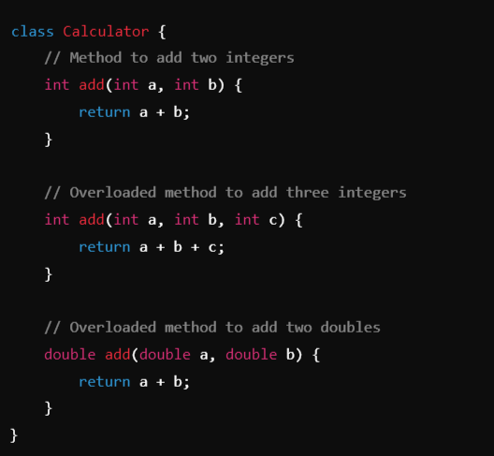
Example:

Slide 7
Constructor Overloading:
Definition: Constructor overloading occurs when a class has multiple constructors with the same name (the class name) but different parameter lists.
Key Points:
Allows creating objects in different ways depending on the arguments passed.
Like method overloading, constructors must differ in the number, type, or order of parameters.
It provides flexibility in initializing objects with different sets of data.

Slide 8
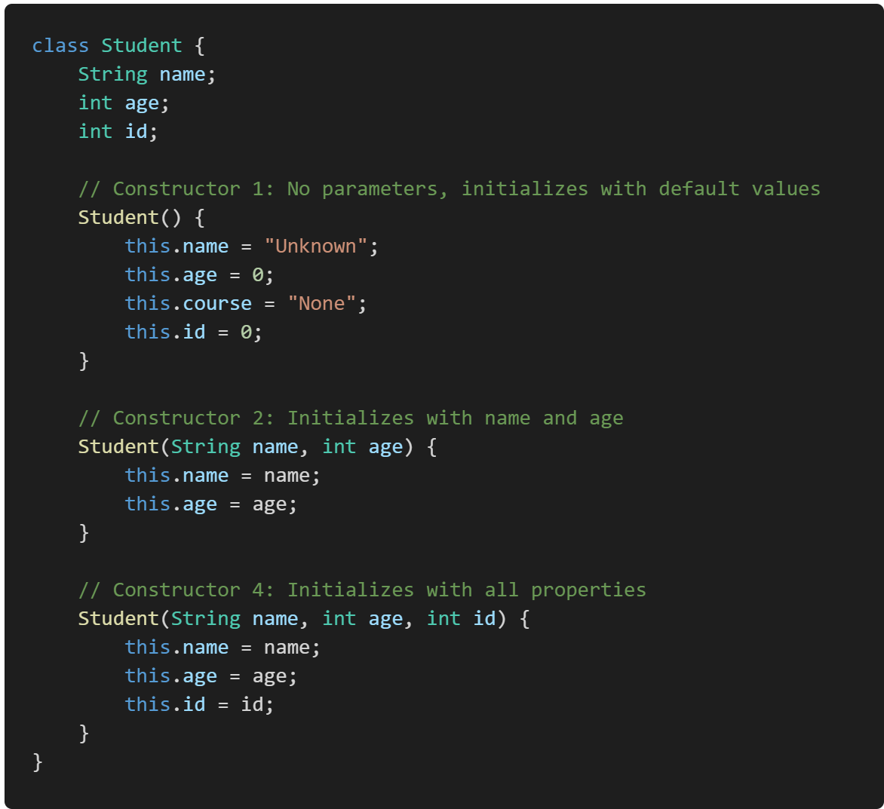
Example:

Slide 9
Run-Time Polymorphism:
Dynamic Binding (Late Binding):
Dynamic binding in Java refers to the process by which a method call is resolved to the appropriate method implementation at runtime, rather than at compile time. This concept is crucial for achieving polymorphism in object-oriented programming.
Implementation:

Slide 10
Method overriding:
Method overriding in Java is a feature that allows a subclass to provide a specific implementation of a method that is already defined in its superclass. This is used to achieve runtime polymorphism and enable the subclass to customize or enhance the behavior of the inherited method.
Key Points of Method Overriding:
Same Method Signature: The overriding method in the subclass must have the same name, return type, and parameters as the method in the superclass.
Annotation: The @Override annotation is often used above the method in the subclass to indicate that it is overriding a method from its superclass (though it is optional).
Access Modifiers: The access level of the overriding method cannot be more restrictive than the overridden method.
Instance Methods Only: Only instance methods (non-static methods) can be overridden. Static methods are not overridden but are hidden instead.

Slide 11
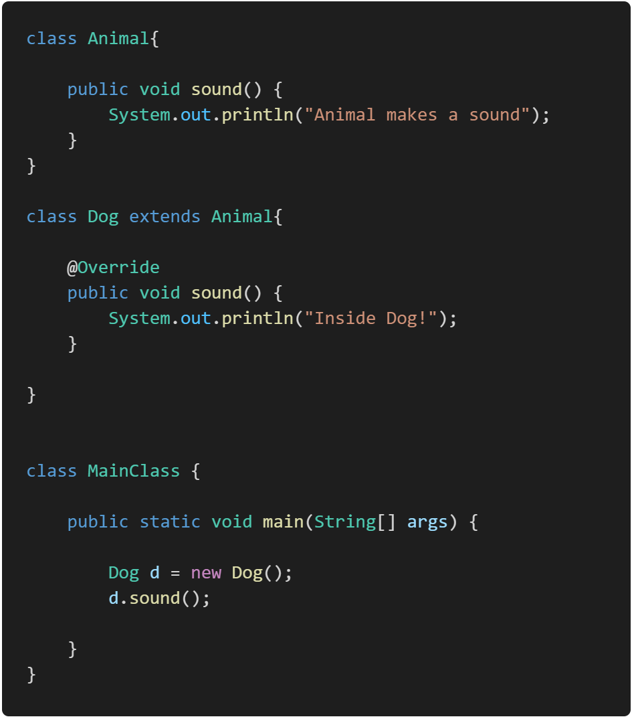
Example:

Slide 12
How to Prevent Method Overriding

Slide 13
Garbage Collection:
In Java is an automatic memory management process that helps reclaim memory occupied by objects that are no longer in use, thus preventing memory leaks and optimizing the application’s performance.

Slide 14
Module-2:
MULTIPLE INHERITANCE

Slide 15
Inheritance:
Inheritance is a fundamental concept in object-oriented programming (OOP) that allows a new class (known as a subclass or child class) to inherit properties and behaviors (fields and methods) from an existing class (known as a superclass or parent class). This promotes code reusability and establishes a natural hierarchical relationship between classes.
Key Points:
Super Class (Parent Class):
The class from which properties and methods are inherited.
Example: Animal might be a superclass.
Sub Class (Child Class):
The class that inherits from another class. It can add its own properties and methods, or override the inherited ones.
Example: Dog might be a subclass of Animal.

Slide 16
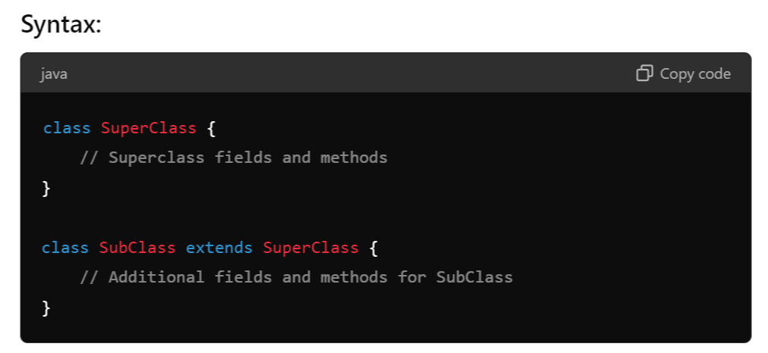

Slide 17
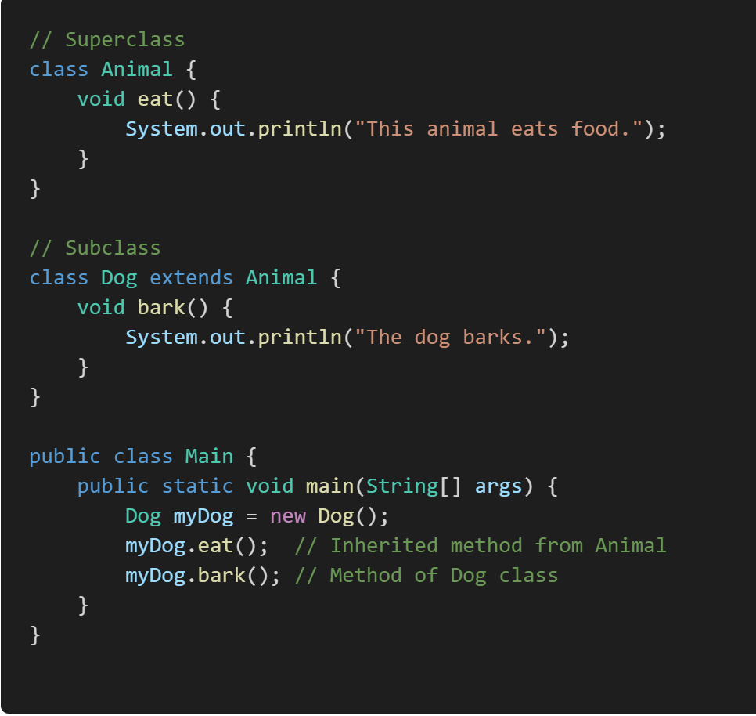
Example:

Slide 18
Inheritance Hierarchies:
An inheritance hierarchy represents the relationships among classes in a multi-level manner, where classes are derived from other classes in a chain.
Single Inheritance: A subclass inherits from only one superclass.
Multi-Level Inheritance: A chain of inheritance where a class is derived from another derived class.
Multiple Inheritance: A class derived from more than one Super class.
Hierarchical Inheritance: Multiple subclasses inherit from a single superclass.
Hybrid Inheritance: A combination of more than one type of inheritance.
Note:
Java doesn't directly support multiple inheritance due to the Diamond Problem, but it can be achieved through interfaces.

Slide 19
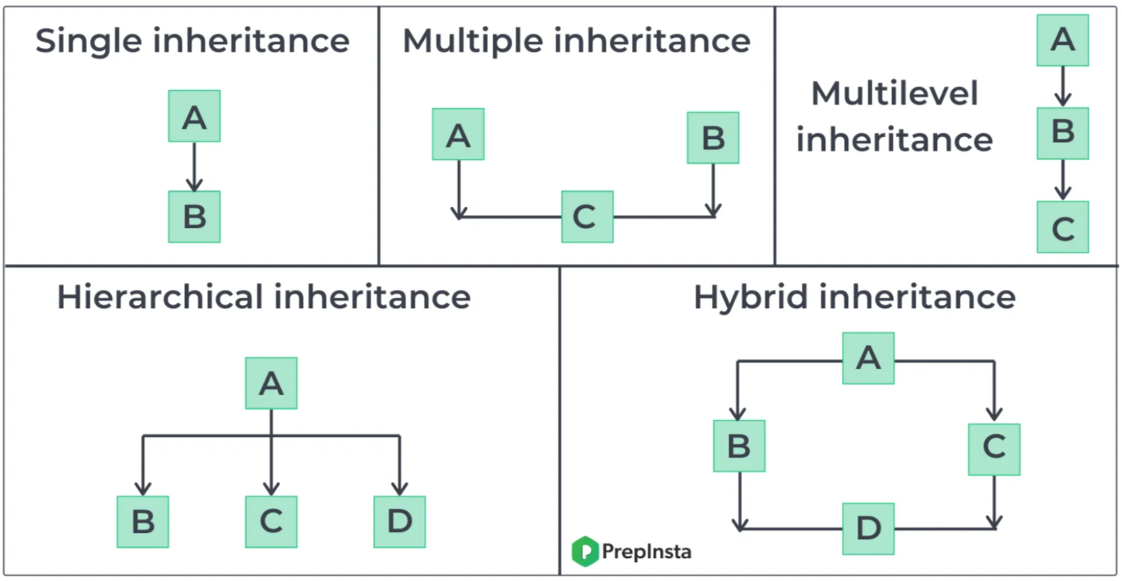

Slide 20
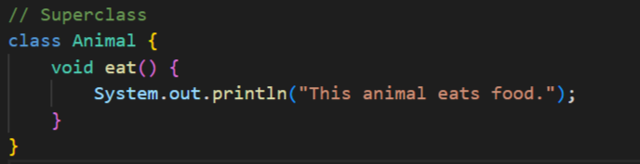
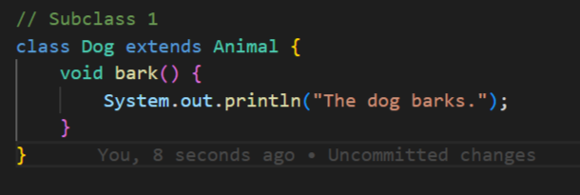
Example:

Slide 21
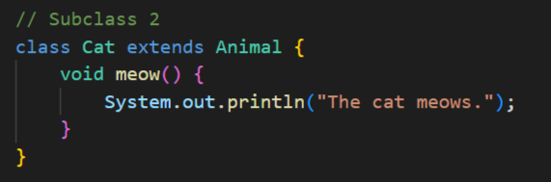
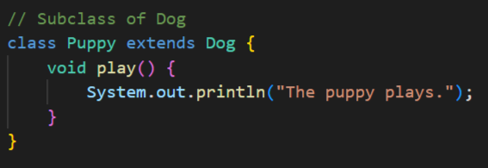

Slide 22
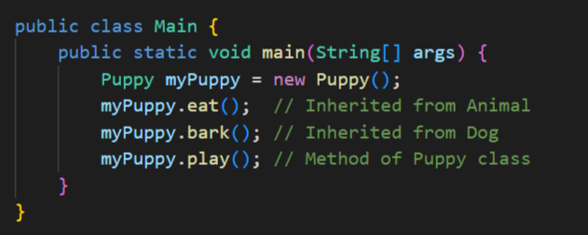

Slide 23
super Keyword:
The super keyword in Java is used in three main contexts:
Accessing the Parent Class Constructor
Accessing Parent Class Methods
Accessing Parent Class Fields
Overall, super is mainly used to differentiate between members of a parent class and the current class, ensuring the correct fields, methods, or constructors are accessed.
Note:
super: The super keyword is used to refer to the immediate parent class. However, super can only be used within a method or a constructor. You cannot use super directly in the class body

Slide 24
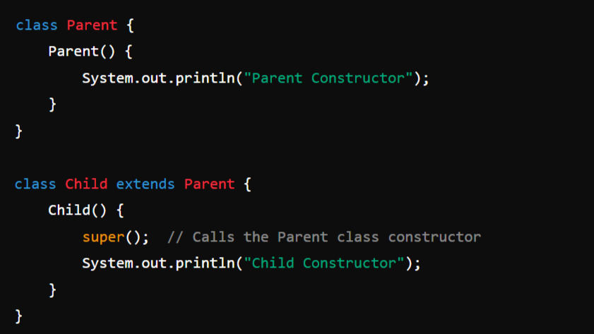
1. Accessing the Parent Class Constructor:
It is used to call a constructor of the parent class from a subclass. This is typically done to initialize the parent class's fields when an instance of the subclass is created.
Example:

Slide 25
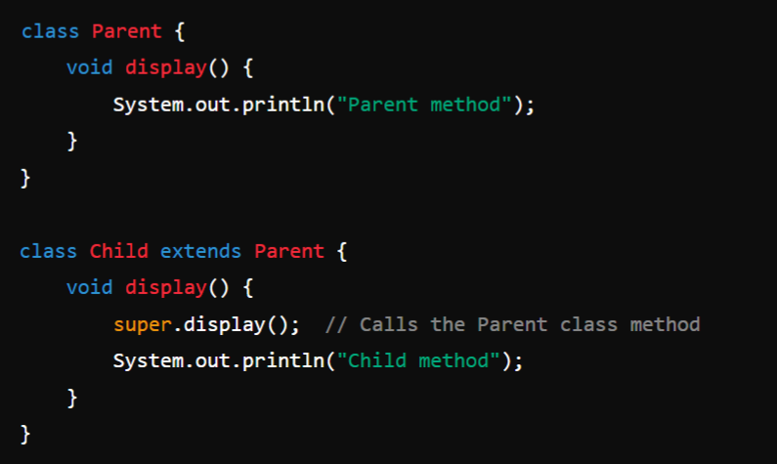
2. Accessing Parent Class Methods:
super can be used to call a method from the parent class that has been overridden in the child class.
Example:

Slide 26
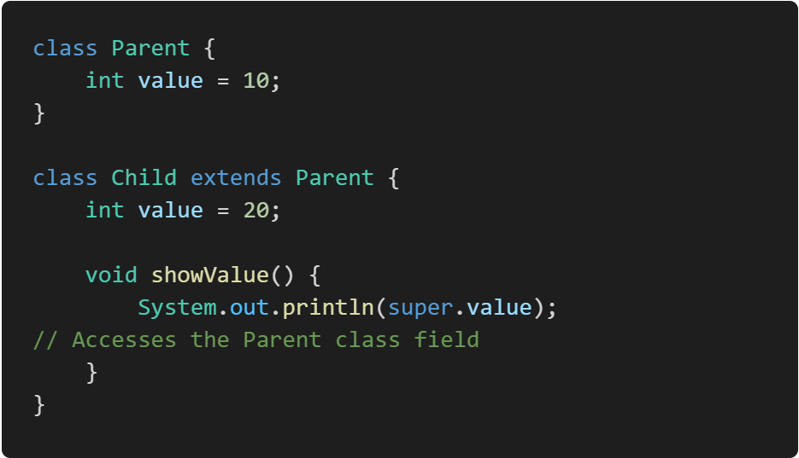
3. Accessing Parent Class Fields:
If a field in a subclass hides a field in its superclass, super can be used to refer to the superclass's field.
Example:

Slide 27
Preventing inheritance:
final Keyword:
In Java, the final keyword can be applied to classes and methods to restrict their usage or modification.

Slide 28
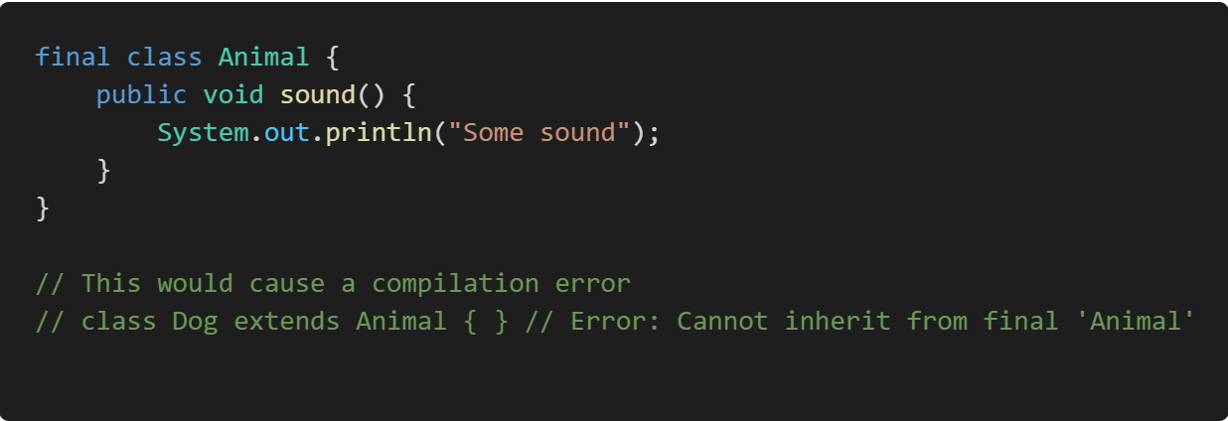
final Classes:
A final class is a class that cannot be subclassed or extended. This is useful when you want to prevent other classes from inheriting your class, ensuring that its implementation remains unchanged.
Example:

Slide 29
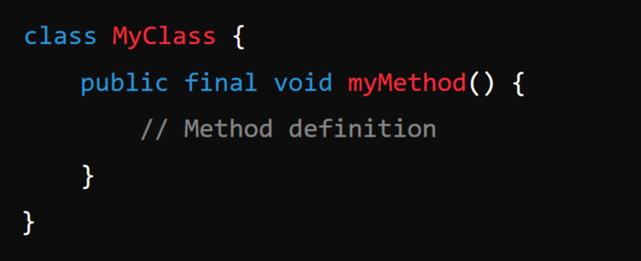
final Methods:
A final method is a method that cannot be overridden by subclasses. This is useful when you want to ensure that a method's implementation remains unchanged in any subclass.
Syntax:

Slide 30
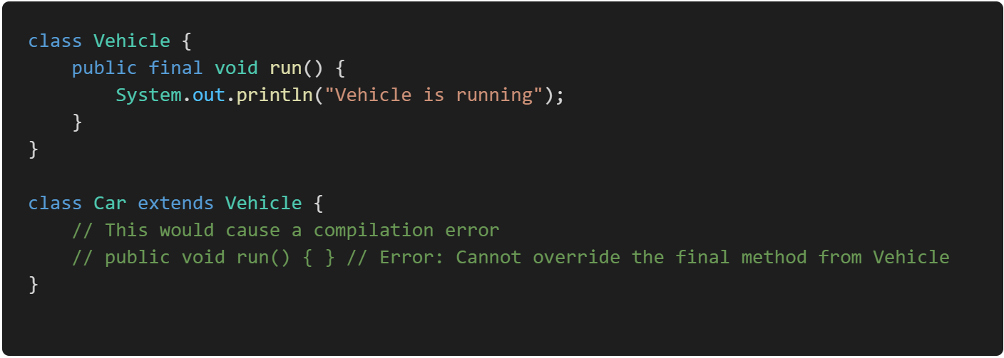
Example:

Slide 31
Object Class:
In Java, an Object is the root class of the Java class hierarchy. Every class in Java is implicitly a subclass of the Object class, either directly or indirectly. This means that all Java classes inherit the methods defined in the Object class.
When I say "every class in Java is implicitly a subclass of the Object class," I mean that no matter what class you create in Java, it automatically inherits from the Object class, even if you don’t explicitly specify a parent class. This inheritance happens by default.

Slide 32
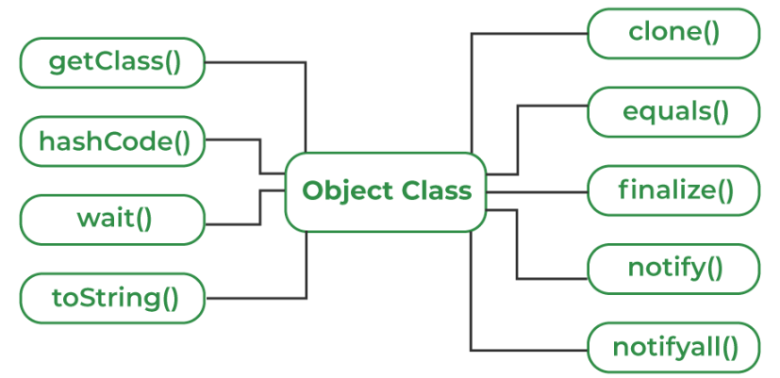
Methods of Object Class:
Object class is present in java.lang package. Every class in Java is directly or indirectly derived from the Object class. If a class does not extend any other class then it is a direct child class of Object and if extends another class then it is indirectly derived. Therefore the Object class methods are available to all Java classes. Hence Object class acts as a root of the inheritance hierarchy in any Java Program.
Methods:

Slide 33
toString(): Returns a string representation of the object.
Syntax:
public String toString()

Slide 34
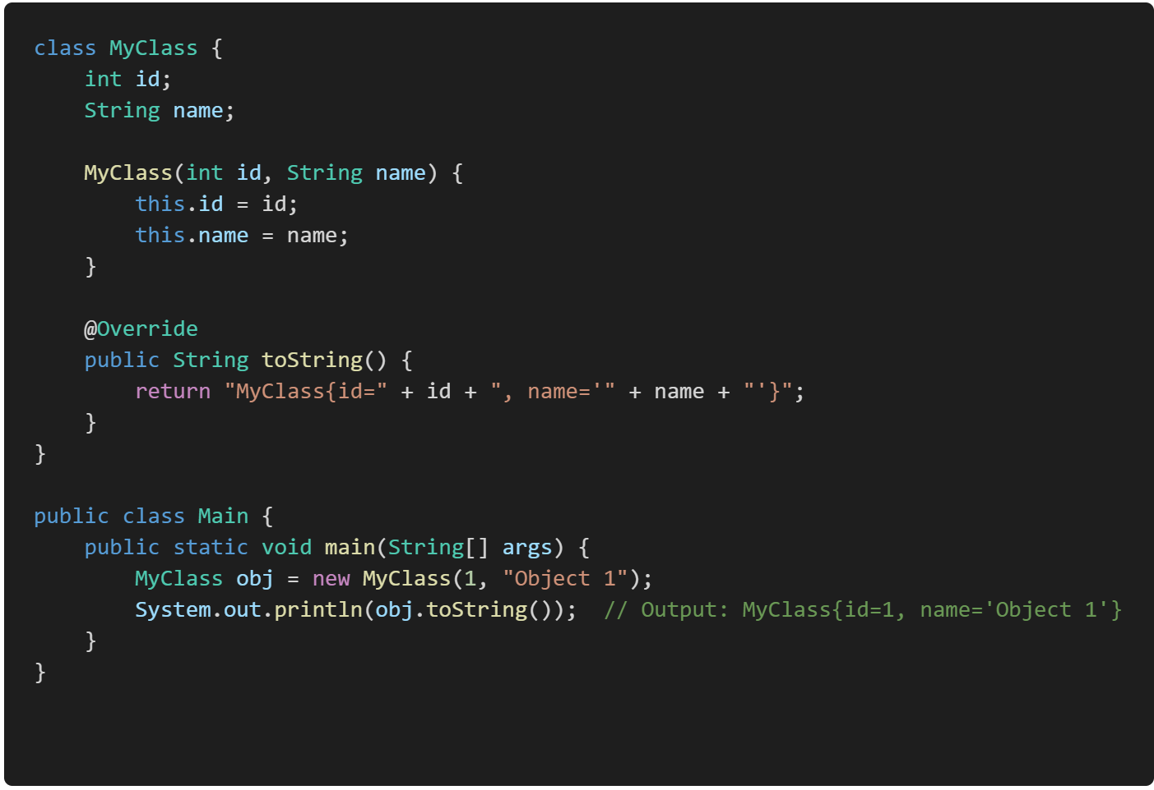
Example:

Slide 35
2. equals(Object obj): Compares this object with the specified object for equality.
Syntax:
public boolean equals(Object obj)

Slide 36
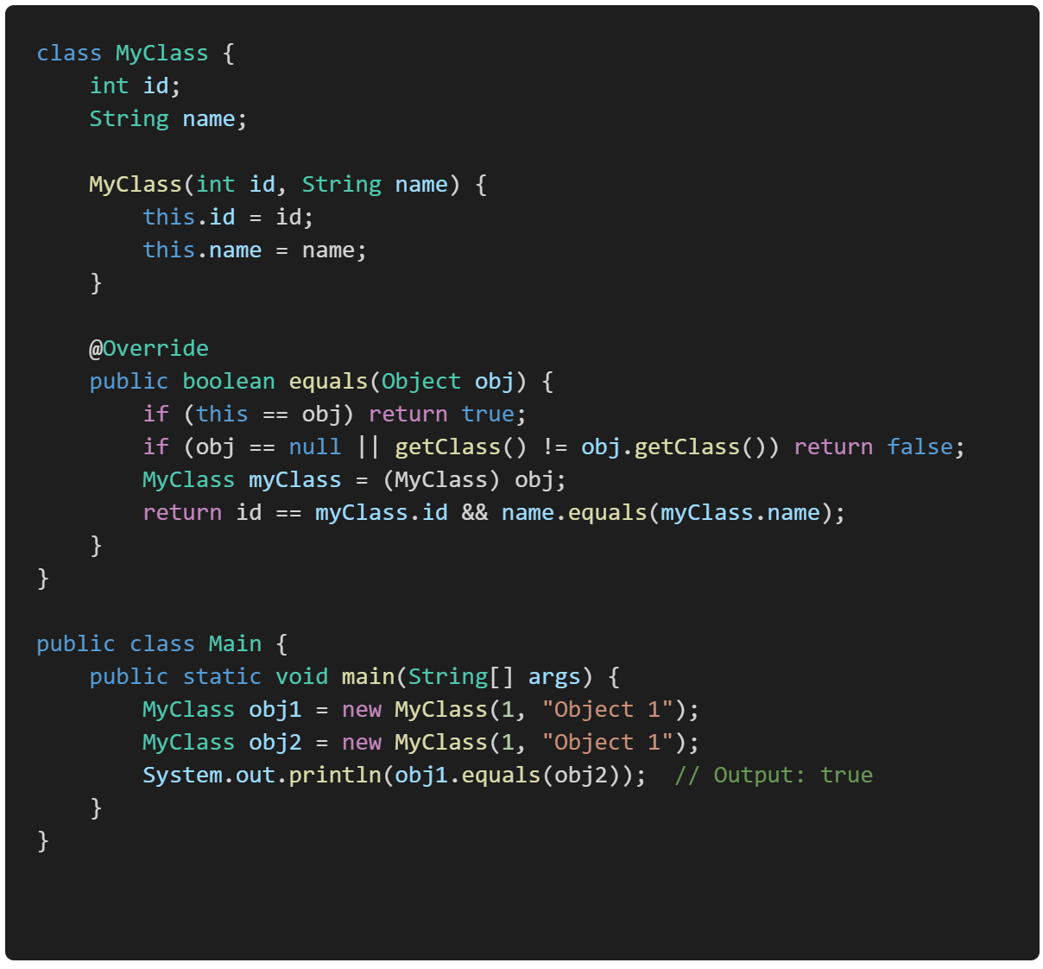
Example:
The equals method in the above example is a custom implementation of the equals() method in Java. This method is used to compare two objects for equality, and it’s typically overridden in classes where you want to define what it means for two objects to be considered "equal."

Slide 37
3. hashCode(): Returns a hash code value for the object, which is used in hashing-based collections like HashMap.
A hash code value is an integer that is generated by the hashCode() method in Java. This value is used to uniquely represent an object in hashing data structures like HashMap, HashSet, and Hashtable.
Syntax:
public int hashCode()

Slide 38
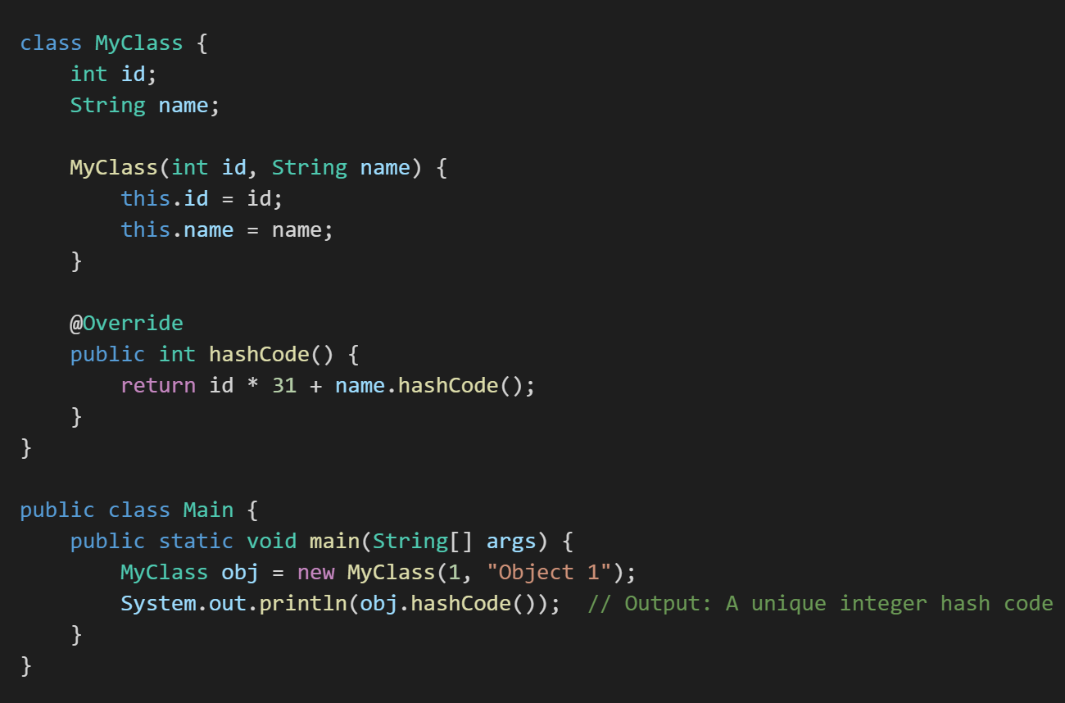
Example:

Slide 39
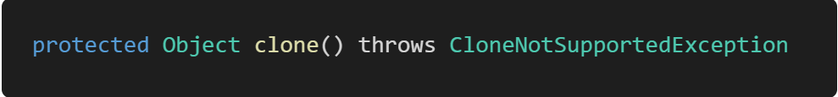
4. clone():
Purpose: Creates and returns a copy (clone) of the object. The class must implement the Cloneable interface.
Syntax:

Slide 40
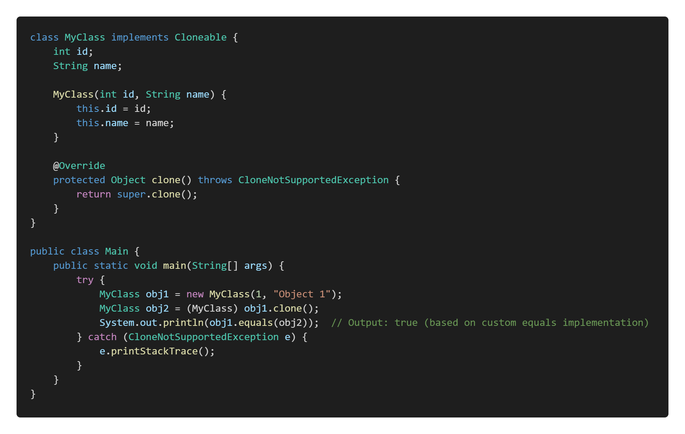
Example:

Slide 41
5. finalize():
The finalize() method in Java is a special method that the garbage collector calls before an object is removed from memory. It allows the object to perform any cleanup operations, such as releasing resources or closing files. However, it is rarely used because relying on finalize() can lead to unpredictable behavior. So this will be handled by the Garbage Collector Automatically.
Syntax:
protected void finalize() throws Throwable

Slide 42
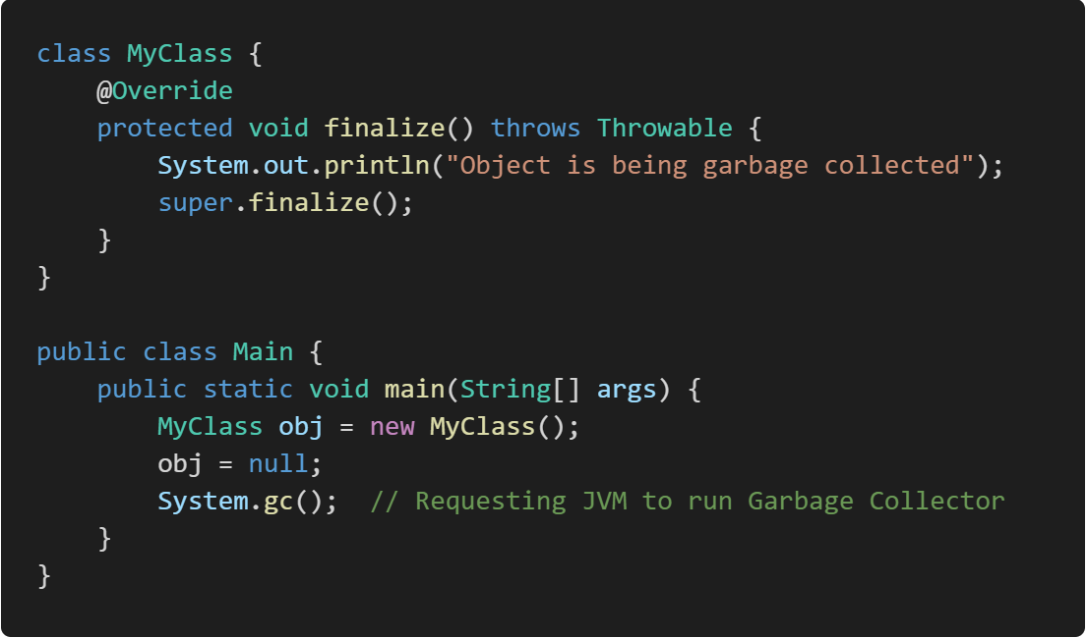
Example:

Slide 43
6. getClass(): Returns the runtime class of the object.
In Java, the getClass() method is used to obtain the runtime class of an object. The runtime class of an object refers to the actual class type of the object as it exists during the execution of the program, not necessarily the type as known at compile time.
For example, if you have a variable declared as Object but it actually references an instance of String, calling getClass() on that variable will return the Class object representing String. This can be useful for reflection, debugging, or when you need to perform operations based on the exact type of the object at runtime.

Slide 44
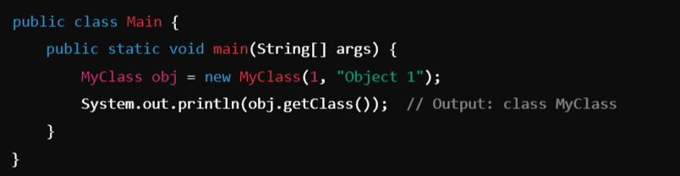
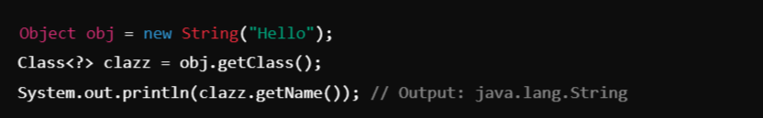
Example-1:
Example-2:

Slide 45
7. notify() :
In Java, the notify() method is used in multi-threaded programming to wake up a single thread that is waiting on the object's monitor (lock). Here's a brief explanation:
Context: When multiple threads are involved in a task, some threads might need to wait for certain conditions to be met before they can proceed. This is typically done using the wait() method, which causes a thread to wait until another thread notifies it that it can continue.
Usage of notify(): The notify() method is called on an object to wake up one of the threads that is currently waiting on that object's monitor. Only one thread is awakened, and it is chosen by the JVM (Java Virtual Machine) in a somewhat random fashion if multiple threads are waiting.
Syntax: public final void notify()

Slide 46
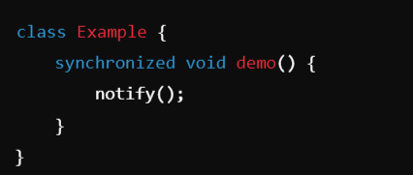
Example:
Synchronized Method (demo()):
The demo() method is marked as synchronized. This means that when a thread calls demo() on an instance of Example, it acquires the lock (monitor) on that instance before executing the method.
Only one thread can execute the demo() method at a time on the same object. If another thread tries to call demo() or any other synchronized method on the same object, it will block (wait) until the lock is released.
So here only one instance of Example will hold the control until and unless it calls the demo() method and inside it will execute the notify() method to release the lock, so that other objects can access it. notify() is used to wake up one thread that is waiting on the object’s lock (monitor).

Slide 47
8. notifyAll(): Wakes up all threads that are waiting on this object's monitor (Internal Lock). This lock, or monitor, is a mechanism that ensures that only one thread can access a synchronized block or method on that object at a time.
Syntax: public final void notifyAll()
When a thread calls notifyAll() on an object, all threads that are currently waiting on that object's monitor (using the wait() method) are awakened.
These threads do not immediately resume execution; they must re-acquire the lock on the object before they can proceed. Since only one thread can hold the lock at a time, the awakened threads will compete to acquire it.
Like notify(), notifyAll() must be called from a synchronized context, meaning the thread must have the monitor (lock) of the object.

Slide 48
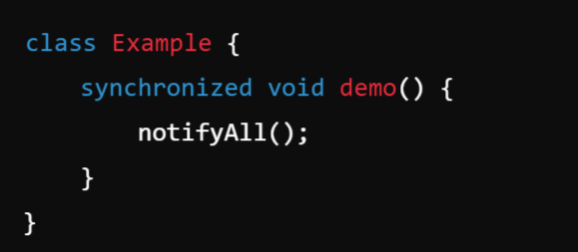
Example:

Slide 49
9. wait() and wait(long timeout):
Causes the current thread to wait until another thread invokes notify() or notifyAll() on this object. So the wait() method will make the current thread pause its execution until another thread signals it to continue.
Syntax:
public final void wait() throws InterruptedException
public final void wait(long timeout) throws InterruptedException

Slide 50
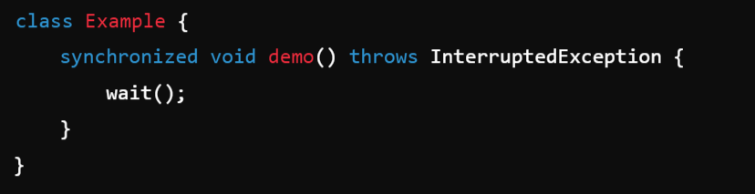
Example:
The wait(1000) method is called inside demo(), which tells the current thread to wait for up to 1,000 milliseconds (1 second).
This method causes the current thread to release the lock on the object (in this case, the instance of Example), and the thread enters a waiting state.

Slide 51
Data Abstraction
Abstract Classes and Methods

Slide 52
Abstract Method:
An abstract method is a method declared without a body. It must be overridden in the subclass. The method signature includes the abstract keyword, and there is no method body.
Key Rules for Abstract Methods:
Must be declared in an abstract class.
Cannot have a method body.
Subclasses that extend the abstract class must override the abstract method.

Slide 53
Abstract Class:
An Abstract Class in object-oriented programming is a class that cannot be instantiated directly. It serves as a blueprint for other classes. Abstract classes are used when you want to define some common behavior (methods) that other classes should inherit and implement, but the abstract class itself should not be instantiated. In other words, an abstract class can have abstract methods (without implementation) and/or concrete methods (with implementation).

Slide 54
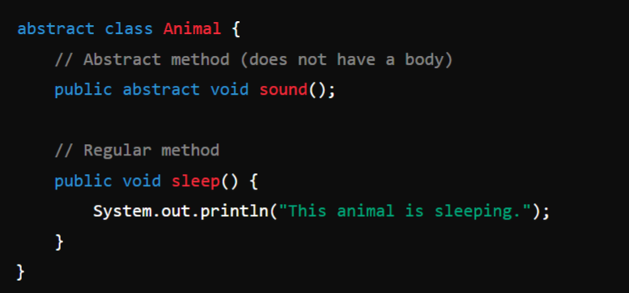
Example:

Slide 55
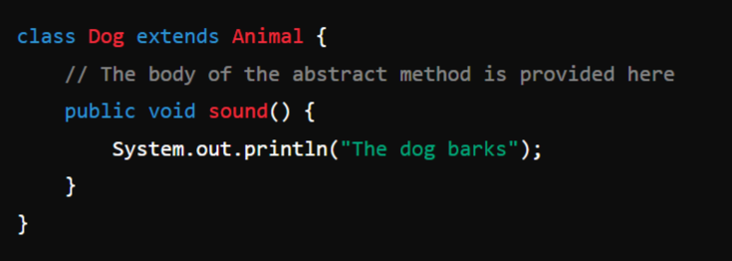
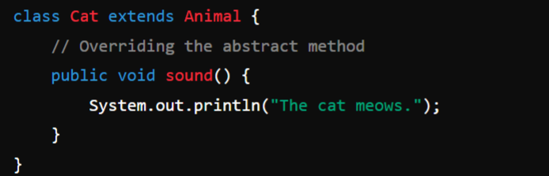
Usage:

Slide 56
Rules for Abstract Classes:
Cannot be instantiated
Can have abstract methods
Can have concrete methods
Subclasses must override abstract methods
Subclasses can be abstract

Slide 57
Module-2: MULTIPLE INHERITANCE
Inheritance: Inheritance hierarchies, super and subclasses, member access rules, super keyword,
Preventing inheritance: final classes and methods, the object class and its methods.
Polymorphism: dynamic binding, method overriding ,abstract classes and methods.
Module-3: INTERFACES AND PACKAGES
Interface: Interfaces VS Abstract classes, defining an interface, implement interfaces, accessing implementations through interface references, extending interface.
Packages: Defining creating and accessing a package, understanding CLASSPATH, importing packages

Slide 58
final Keyword:
When Used with Variable
Ex: int age = 20
It Becomes Constant
Ex: final int age = 20
When Used with Class
Ex: class Student {}
Prevents Inheritance
Ex: final class Student {}
When Used with Method
Ex: public void display(){}
This method cannot be Overridden by the Child class
Ex: public final void display(){}

Slide 59
final Classes and Methods:
In Java, the final keyword can be used to mark classes, methods, and variables. When applied to a class or method, it has specific effects:

Slide 60
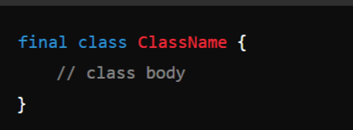
1. Final Class:
A final class cannot be extended (inherited) by any other class. This is useful when you want to prevent inheritance for security reasons, immutability, or to avoid modification of the class.
Syntax:

Slide 61
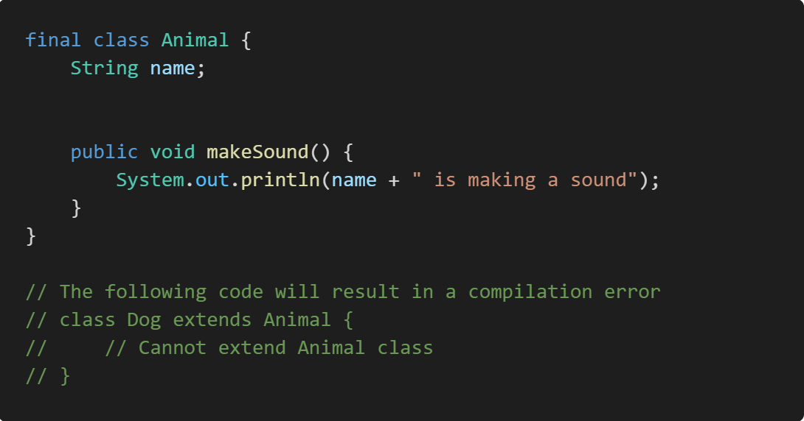
Example:

Slide 62
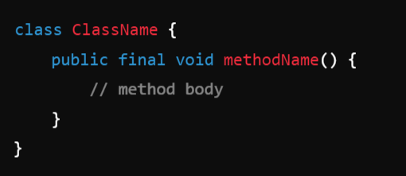
2. Final Method:
A final method cannot be overridden by subclasses. This is useful when you want to ensure that the functionality of a method remains unchanged in all derived classes.
Syntax:

Slide 63
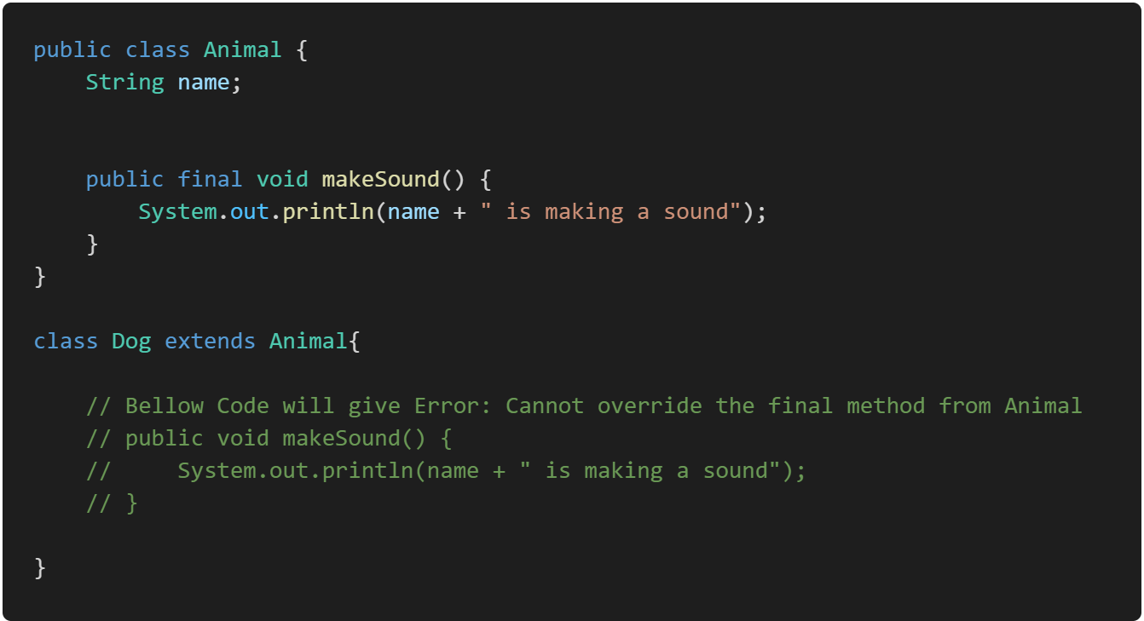
Example:

